Slide 2
BBM384 Software Engineering Laboratory
Hungry Users Food Delivery System (HU-FDS)
Application Type: Web-based
Group 9-PentaCode
Team Members:
Specialized Team Role | Student No | Student Name | Student Surname
Software Project Manager | 2220356040 | Salih Eren | Yüzbaşıoğlu
Software Analyst | 2220356176 | Mustafa Furkan | Ateş
Software Architect | 2210356092 | Yusuf | Küçüköner
Software Configuration Manager | 2210356110 | Şükriye | Öztürk
Software Tester | 2210356065 | Bedirhan | Gençaslan

Slide 3
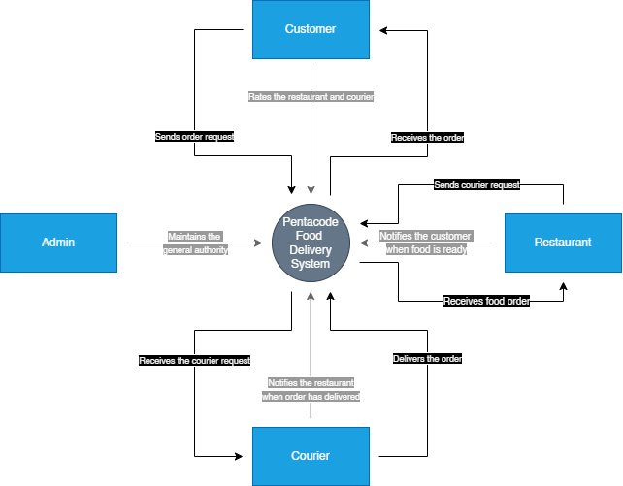
Project Context
This context diagram illustrates the core logic of our food delivery system, HUrricane.
The system is based on the interaction between four main entities: the customer, restaurant, courier, and admin.

Slide 4
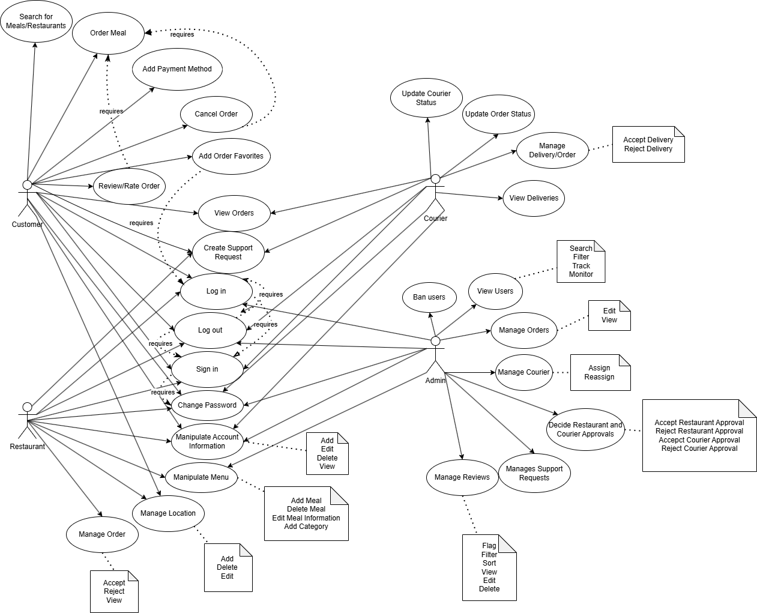
Functional Software Requirements

Slide 5
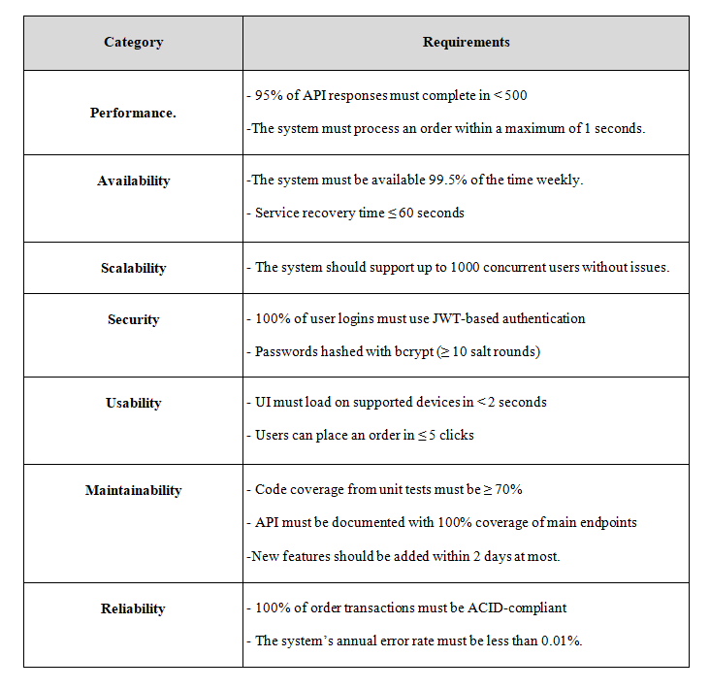
Non-Functional Software Requirements

Slide 6
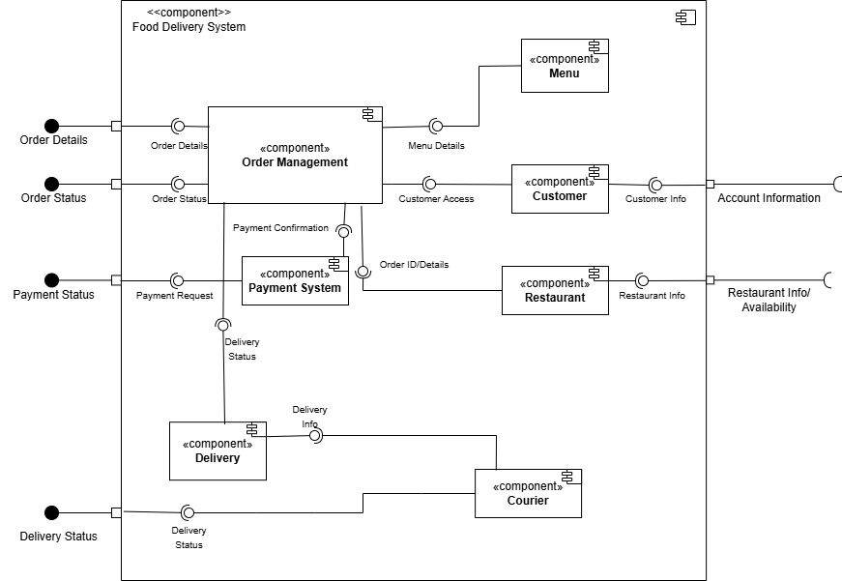
Software Architecture
This component diagram represents the software architecture of the HUrricane Food Delivery System. It highlights key components—like Order Management, Payment System, and Delivery—and their interactions to support modular, maintainable, and scalable design.

Slide 7
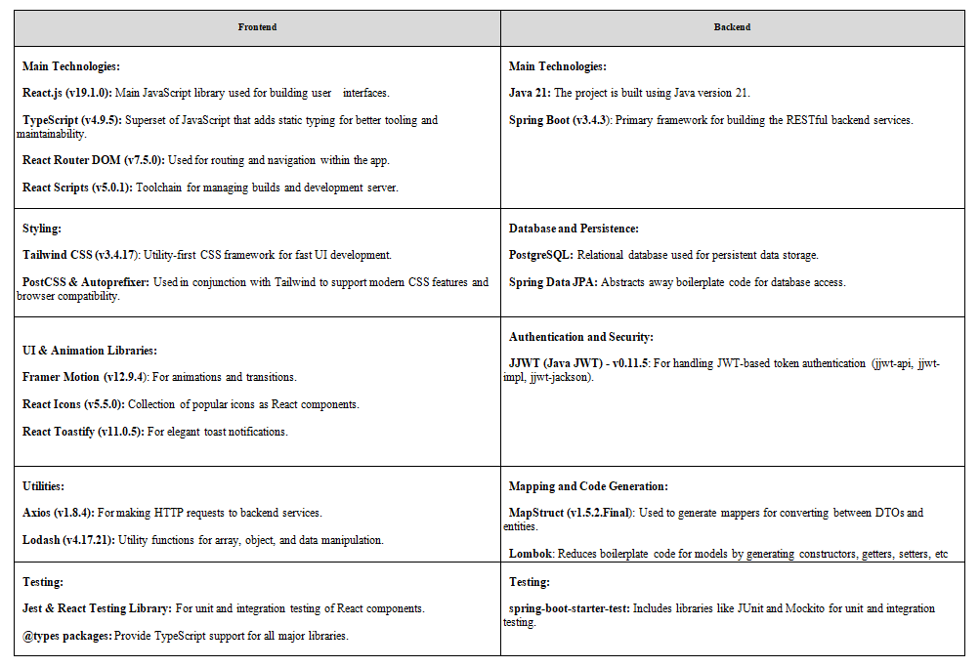
Technological Background

Slide 8
Final Project Demo
<Run the most recent version of your product.>

Slide 9
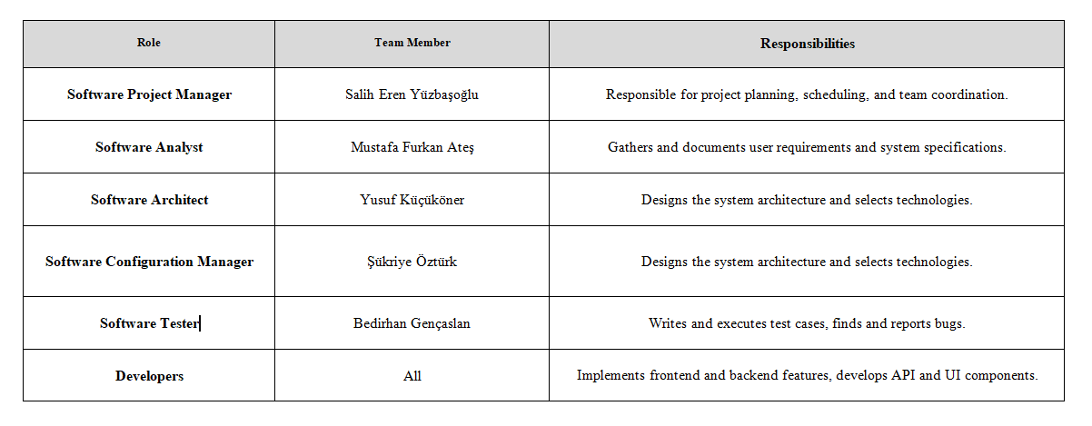
Work Allocation

Slide 10
Work Done By Team Member: Salih Eren Yüzbaşıoğlu
Name | Salih Eren Yüzbaşıoğlu
Role | Project Manager, Software Developer
Tasks Completed | -Coordinated team efforts by assigning tasks and setting clear deadlines. -Designed and deployed a shared cloud database to enable collaborative development. -Developed backend APIs to implement core system functionalities. -Built and maintained frontend pages to support essential system features. -Created Use Case Diagrams to model and communicate key functional requirements.

Slide 11
Work Done By Team Member: Mustafa Furkan Ateş
Name | Mustafa Furkan Ateş
Role | Software Analyst, Software Developer
Tasks Completed | - Created the project’s Gantt Chart and structured the overall development timeline. - Designed the complete User Interface in Figma, including all role-based page layouts. - Set up the React + TypeScript + Tailwind infrastructure and implemented all frontend pages based on Figma. - Implemented routing system and reusable components for dynamic page rendering. - Created Use Case Diagrams to represent the main functional requirements of the system. - Prepared and designed the final presentation slides summarizing the project work.

Slide 12
Work Done By Team Member: Yusuf Küçüköner
Name | Yusuf Küçüköner
Role | Software Architect, Software Developer
Tasks Completed | -Built the foundational project structure for both the backend and frontend. -Implemented core functionalities for all use cases. -Designed and developed the core database schema for all user types. -Created most of backend APIs and their corresponding frontend pages. -Implemented a JWT-based security system with tokens for login and signup. -Developed a ticket-based support system on both backend and frontend to resolve order-related conflicts. -Built an order management system with account-based logic that handles orders per restaurant. -Contributed to team efforts in designing architectural diagrams, including the class diagram. -Implemented a favorites feature for both orders and restaurants.

Slide 13
Work Done By Team Member: Şükriye Öztürk
Name | Şükriye Öztürk
Role | Software Configuration Manager, Software Developer
Tasks Completed | -Designed the core UI elements with Figma and developed the brand identity for our project, HUrricane. -Contributed to all architectural diagrams of the system using tools like Draw.io and Visual Paradigm. -Implemented login and signup pages for all user types using TypeScript and Tailwind CSS on the frontend. -Designed and developed both the backend and frontend of the admin management pages. -Built a password change feature on both the backend and frontend.

Slide 14
Work Done By Team Member: Bedirhan Gençaslan
Name | Bedirhan Gençaslan
Role | Software Tester, Software Developer
Tasks Completed | Frontend Development: I contributed to the development of the user interface by working on various pages and fixing UI-related bugs to improve usability and responsiveness. Test Case Writing: I created detailed test cases that covered key functional scenarios, including different user roles and possible error conditions, to ensure comprehensive test coverage. Testing Process: I conducted manual testing based on the prepared test cases, reported any bugs or inconsistencies, and verified fixes through retesting to ensure overall system stability.

Slide 15
Self-Evaluation of Project Development
As a group, we worked hard together and successfully delivered a high-quality software product that meets the requirements of the course. Through this project, we effectively learned how to develop a software product as a team.
The following achievements reflect this:
Designed and implemented fully functional frontend pages using React and Tailwind CSS
Developed backend endpoints with Spring Boot to support all customer, restaurant, and courier operations
Ensured smooth integration between frontend and backend with real-time API communication
Completed all necessary project documentation (Project Vision, Requirement Specification, Architectural Notebook, Design Document, etc.)
Followed the initial Gantt timeline and delivered the project on time with all planned features

Slide 16
What Would We Do Differently If Starting Again?
We believe that, as a team, we worked collaboratively and successfully delivered a high-quality product. However, throughout the development process, we also encountered areas where we realized we need to improve ourselves. These can be listed as follows:
Improving time management and meeting internal deadlines more strictly
Enhancing communication and coordination, especially during critical development phases
Gaining more experience with backend integration and error handling
Applying more advanced testing strategies for better reliability
Using version control tools like Git without any conflict as a team

Slide 17
Thank You!
Any questions..?

Slide 18
References
System Design Diagrams
Component and Context Diagrams created using draw.io
Deployment and Package Diagrams created using draw.io
Reference for Non-Functional Requirements
GeeksforGeeks article on Non-Functional Requirements in Software Engineering
Project Source Code Repository
Pentacode Backend GitLab Repository

